Slide 1
Ch 17 : pymol Ch 21 : PBD 3D
조강익

Slide 2

http://www.cjphotoclub.net/files/attach/images/15084/360/025/속초-1.jpg

Slide 3

http://www.mowlemandco.com/assets/images/backgrounds/london.jpg

Slide 4
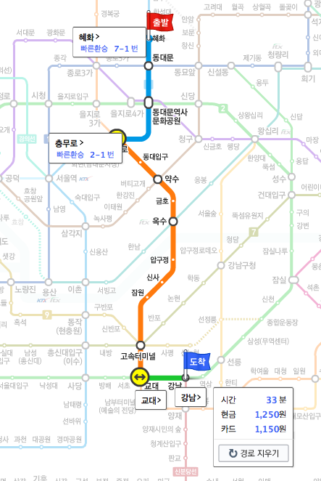
map.daum.net

Slide 5
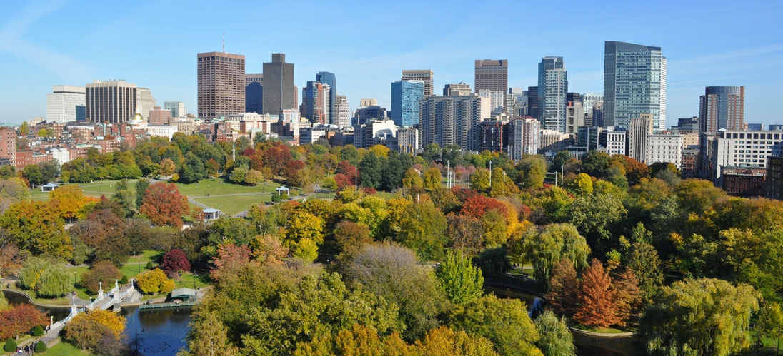
http://americathebeautiful.com/boston_skyline.jpg

Slide 6
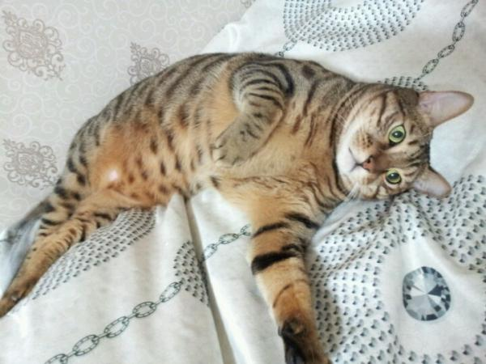
http://www.oeker.net/m/bbs/board.php?bo_table=pet&wr_id=1338698

Slide 7

http://bcs.snu.ac.kr/index2.asp

Slide 8
2014, 2015, 2016, 2017
ㅜㅜ

Slide 9

http://api.ning.com/files/3QWN5yhdbadeAOUurbTSGEOQSkNxuzhaMTKMI-zGrZ*P9dxs4XMhjIMUg9l8nLGn8BFv*MxbvJh17PBBE773uCPe9GZ-9-PG/freeeeeeeeed.jpg

Slide 10


Slide 11

http://www.mental-illness-resources.com/images/schizophrenia.jpg

Slide 12
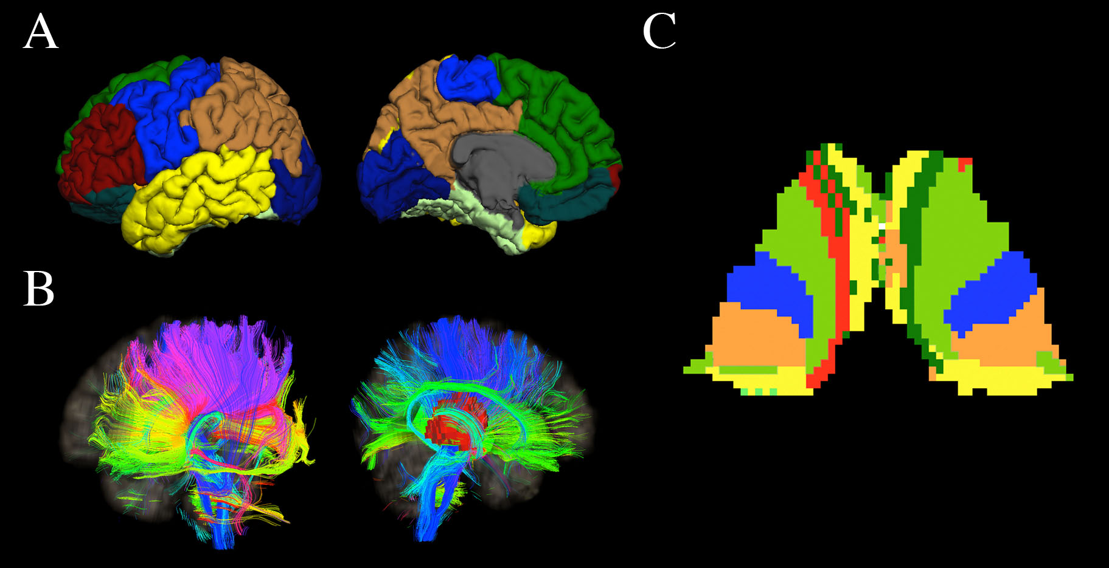

Slide 13
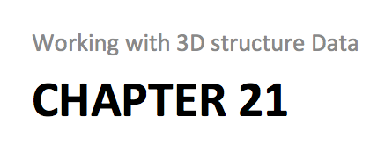
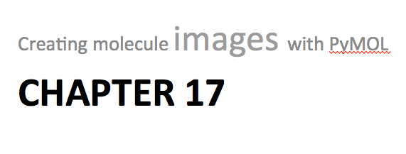
Recipe 14
Recipe 15
Recipe 16

Slide 14
Chapter 21
Working with 3D structure Data

Slide 15
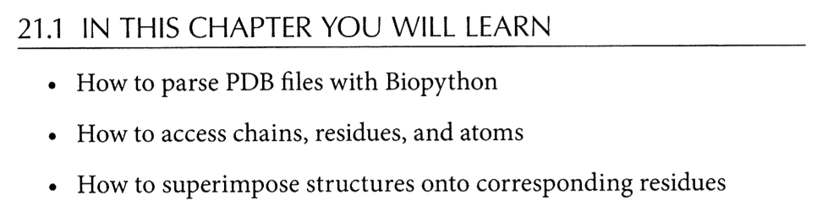

Slide 16
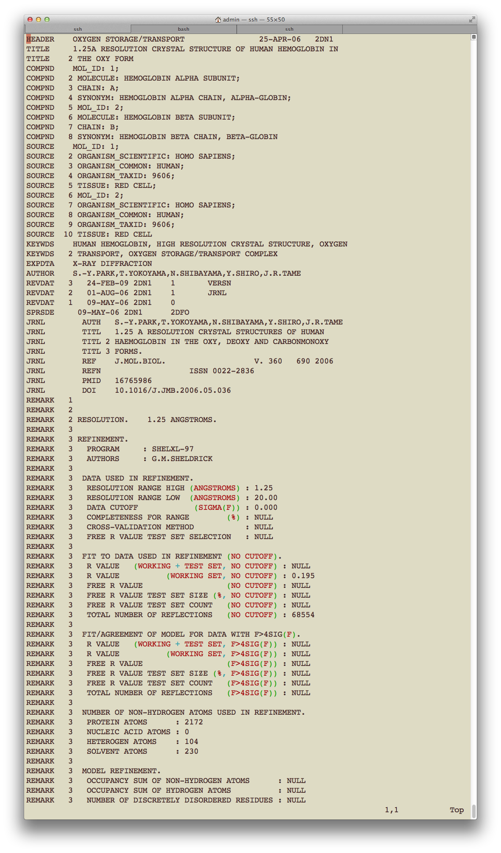

Slide 17
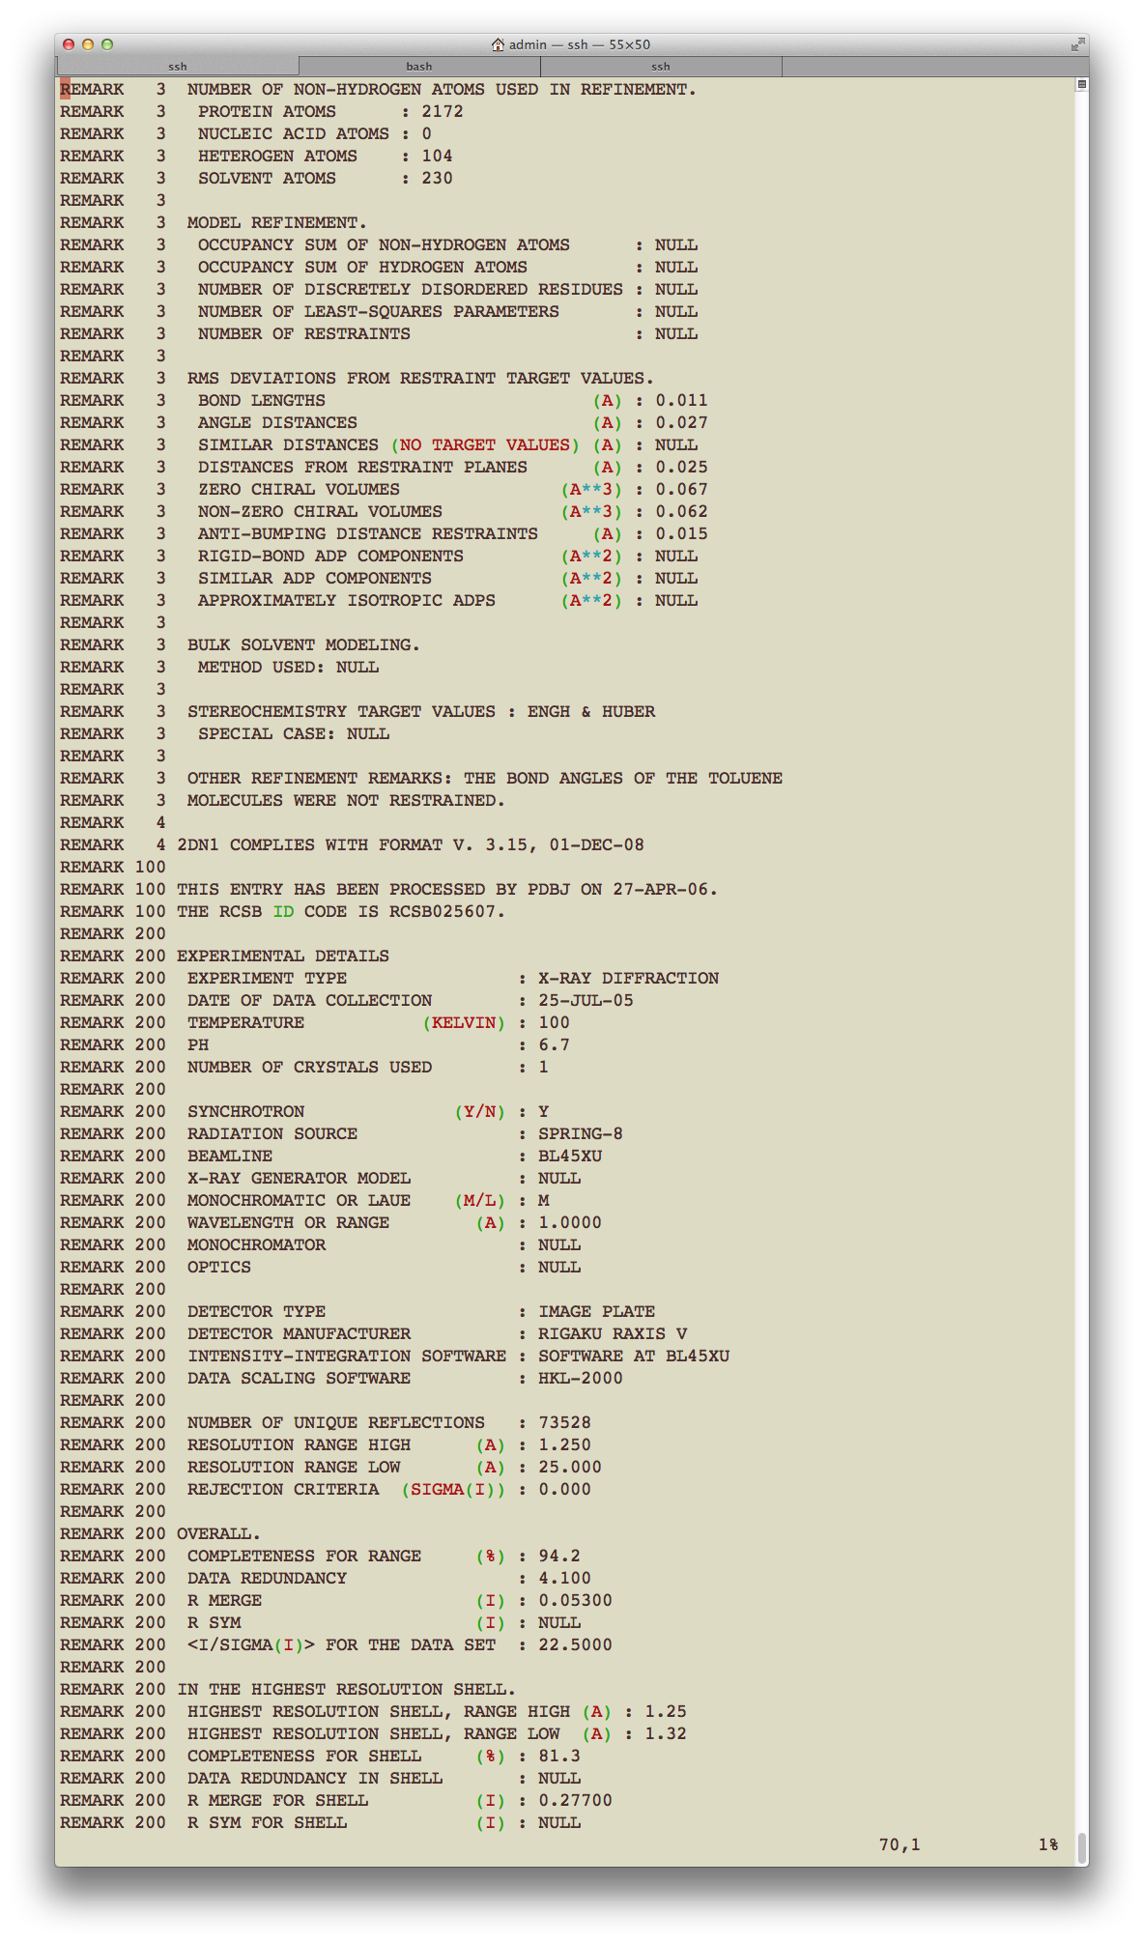

Slide 18
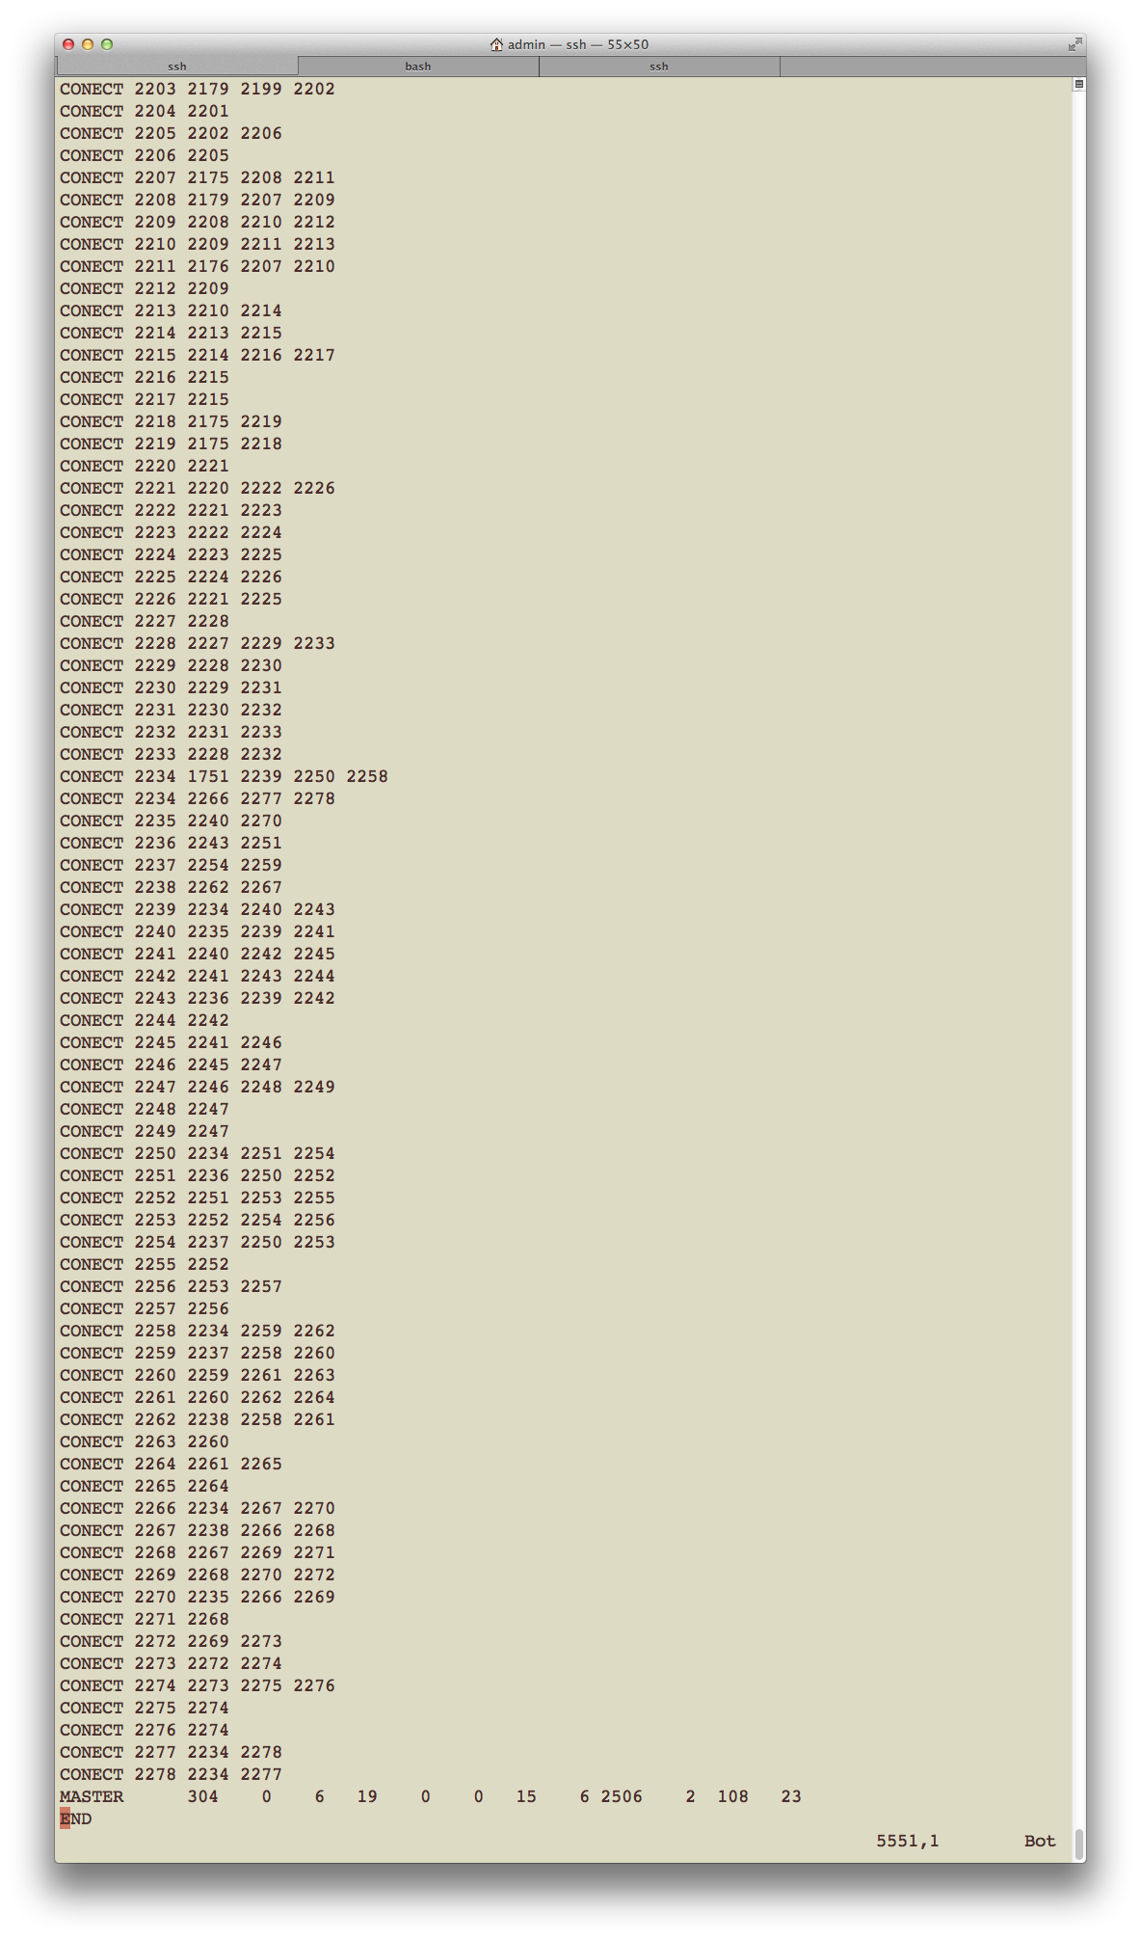

Slide 19
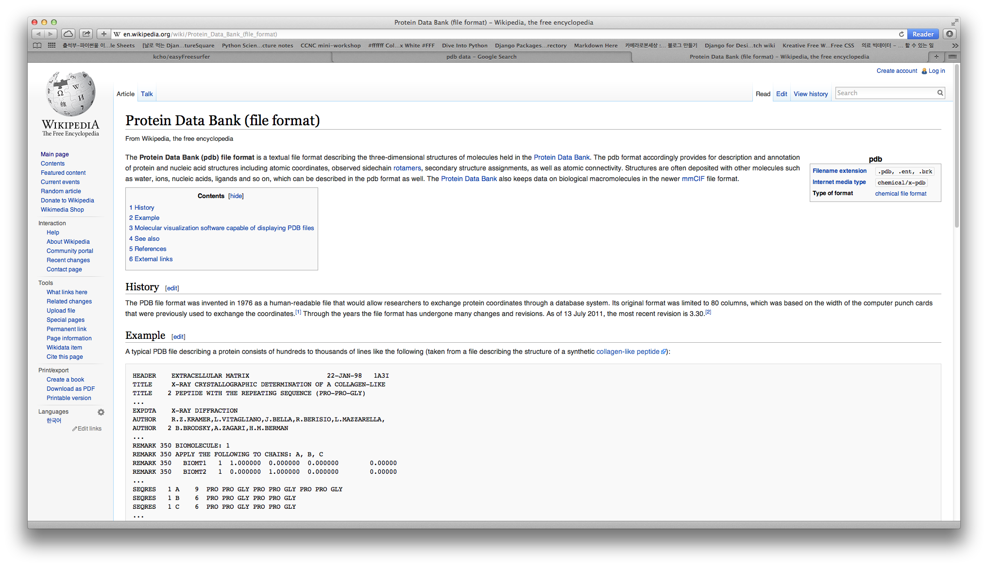
http://en.wikipedia.org/wiki/Protein_Data_Bank_(file_format)

Slide 20
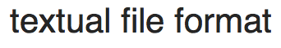
http://en.wikipedia.org/wiki/Protein_Data_Bank_(file_format)

Slide 21
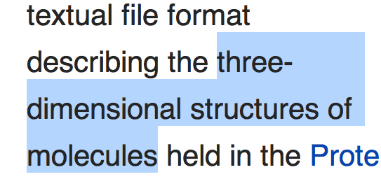
http://en.wikipedia.org/wiki/Protein_Data_Bank_(file_format)

Slide 22
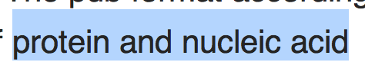
http://en.wikipedia.org/wiki/Protein_Data_Bank_(file_format)

Slide 23
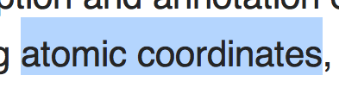
http://en.wikipedia.org/wiki/Protein_Data_Bank_(file_format)

Slide 24
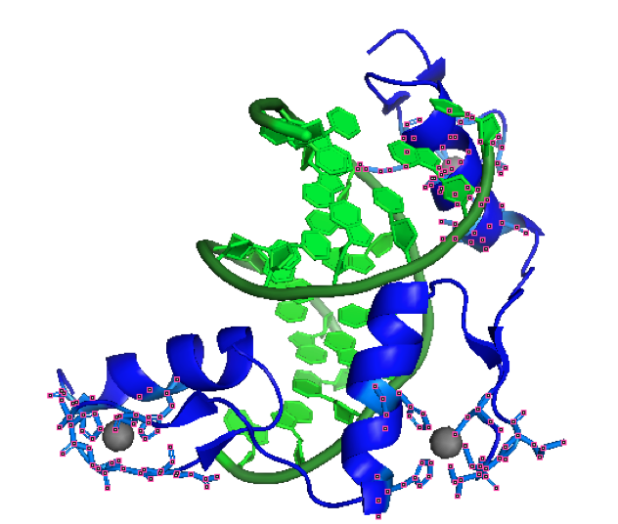
name
location

Slide 25
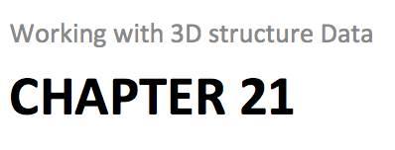
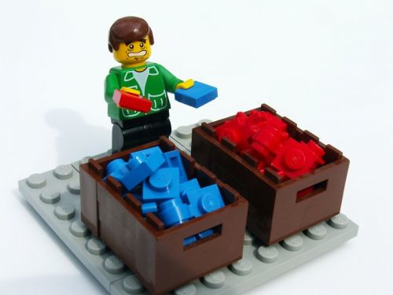
http://www.craiglotter.co.za/wp-content/uploads/2010/04/data-sorting-lego.jpg

Slide 26
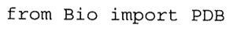

Slide 27

http://www.bloggang.com/data/a/asiaw/picture/1346398879.jpg
Structure
Model
Chain
Residue
Atom

Slide 28
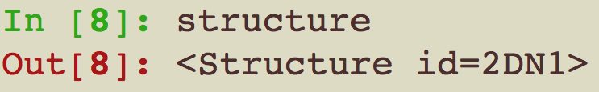

Slide 29
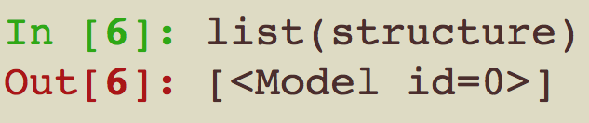
Model

Slide 30
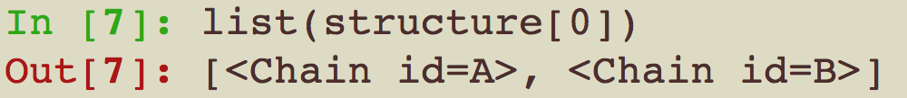

Chain

Slide 31
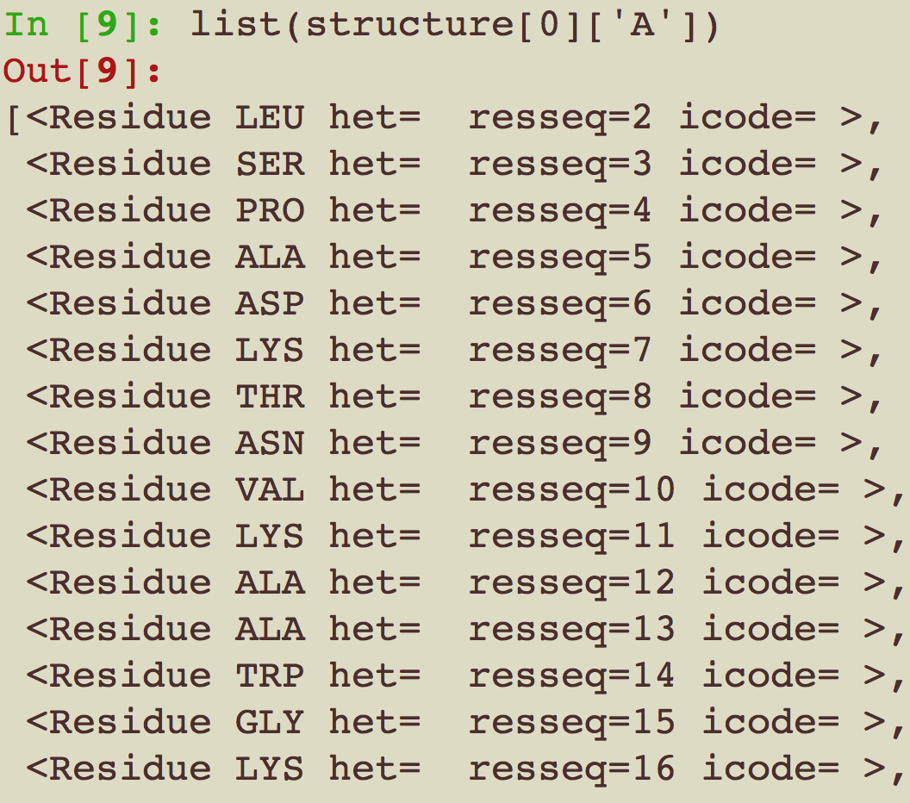
Residue

Slide 32
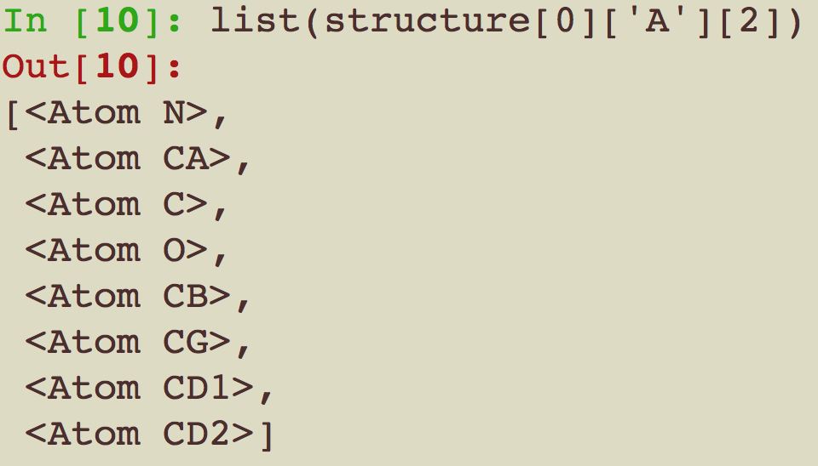
Atom

Slide 33
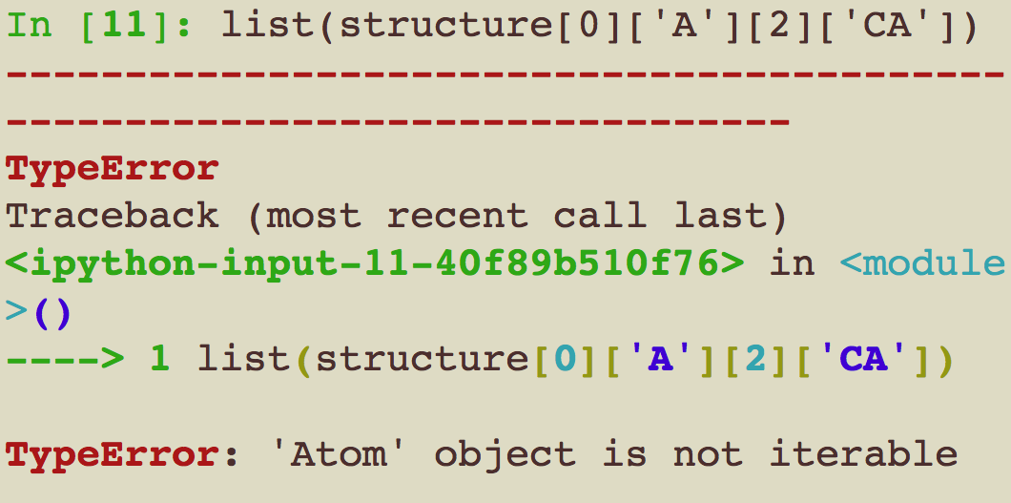

Slide 34
http://www.bloggang.com/data/a/asiaw/picture/1346398879.jpg
Structure
Model
Chain
Residue
Atom

Slide 35
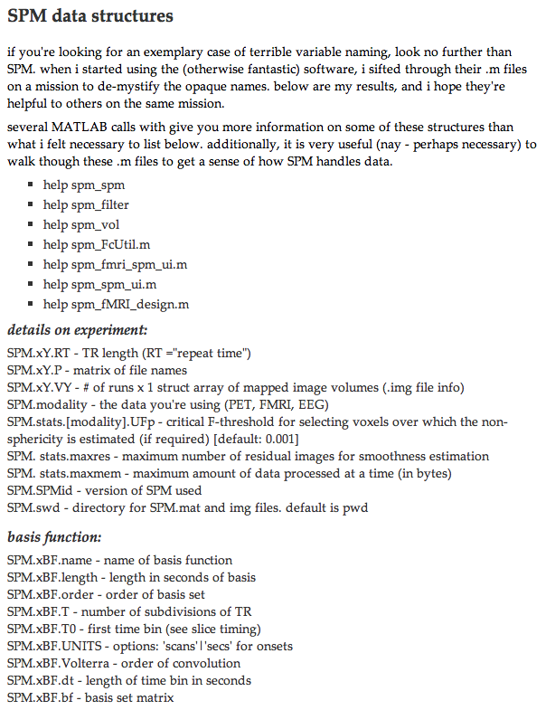
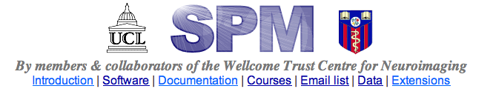
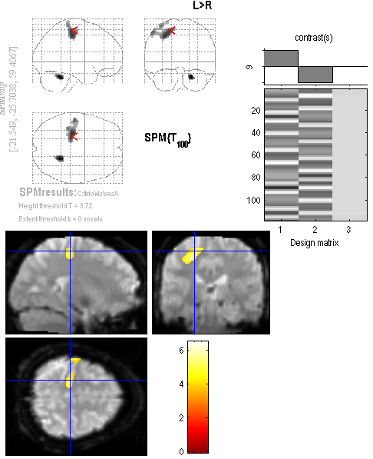
http://www.fil.ion.ucl.ac.uk/spm/
http://www.cabiatl.com/Resources/SPM/spm_results.png
http://www.its.caltech.edu/~nsulliva/spmdatastructure.htm

Slide 36
Chapter 21 Example
Working with 3D structure Data

Slide 37
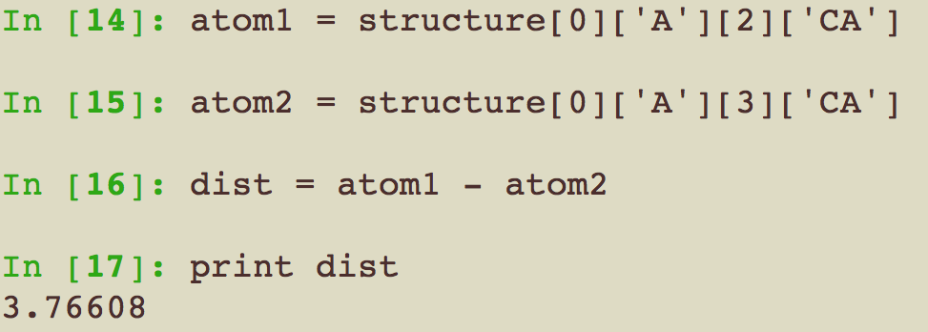
Q. Distance between two atoms

Slide 38
Q. Finding the Two Closest CA atoms In a PDB Structure
Get CA atom list
Loop for position for 1 atom
Loop for position for the other atom
Calculate distance
Compare with previous
Output the minimum distance

Slide 39
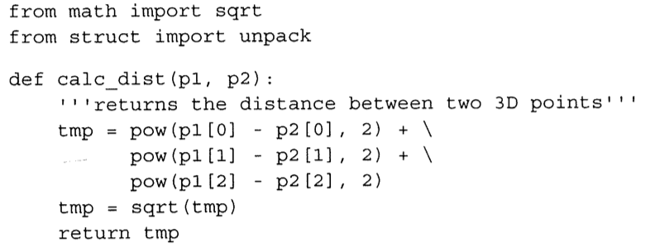

Slide 40
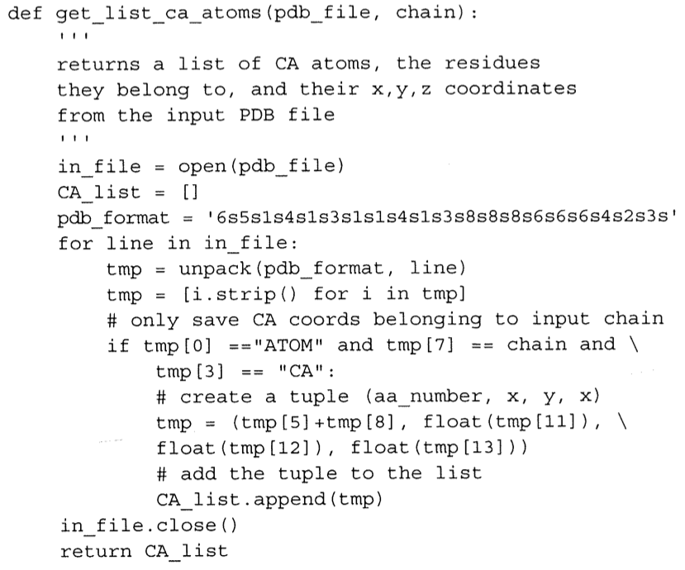

Slide 41
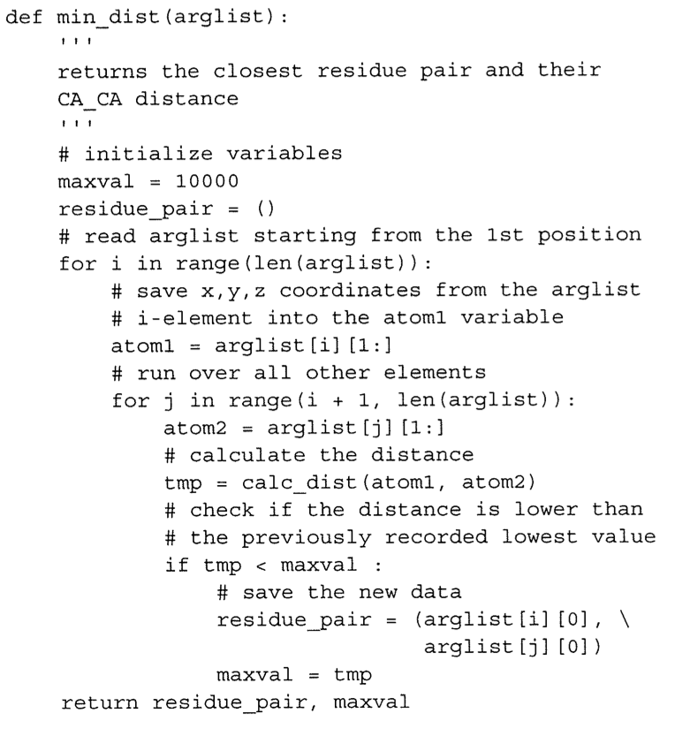

Slide 42
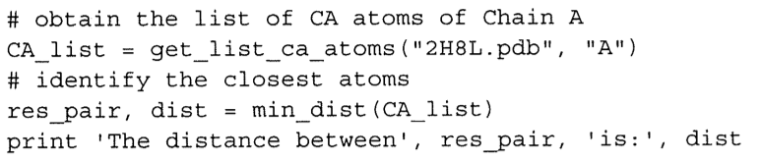

Slide 43
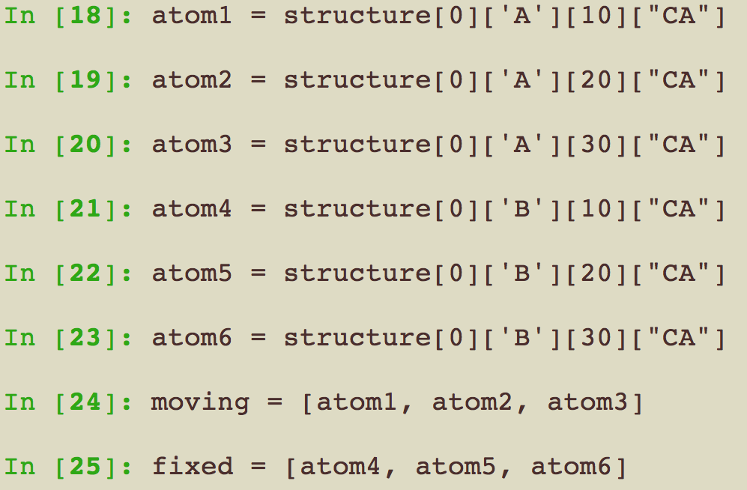
Quality of the fit between two structures

Slide 44
Quality of the fit between two structures

Slide 45
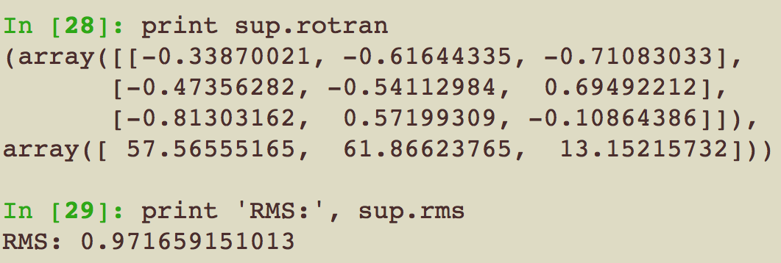
Quality of the fit between two structures

Slide 46
Model
chain_A.pdb
chain_B.pdb

Slide 47
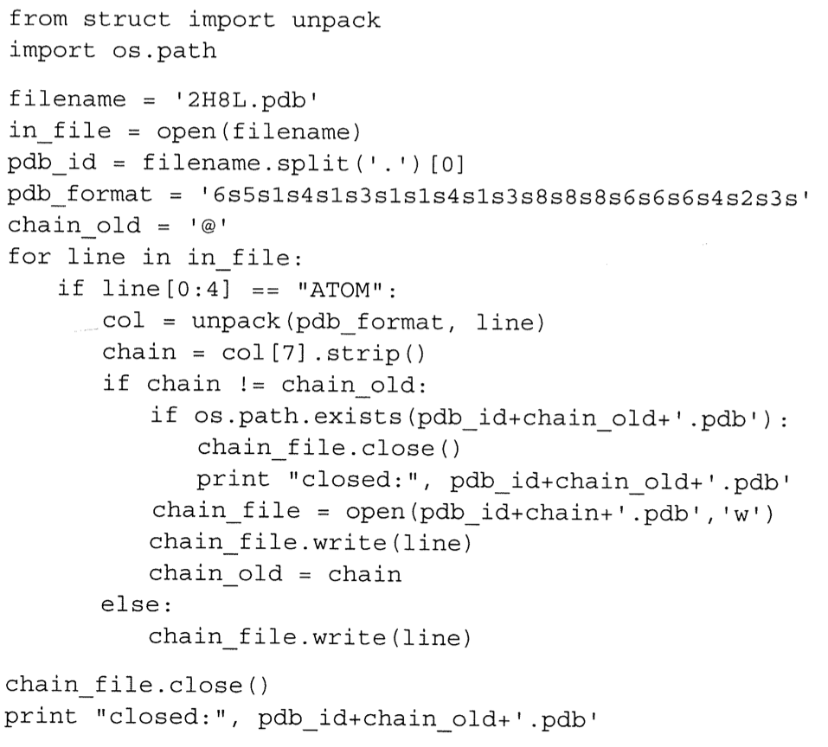

Slide 48
Summary
A lot of data
Bio.PDB
PDB.PDBParser()
PDB.Superimposer()
get_structure
rms, rotran
PDB file
Structure
Hierarchical variable

Slide 49
Chapter 17 + server
Creating molecule images with PyMOL

Slide 50
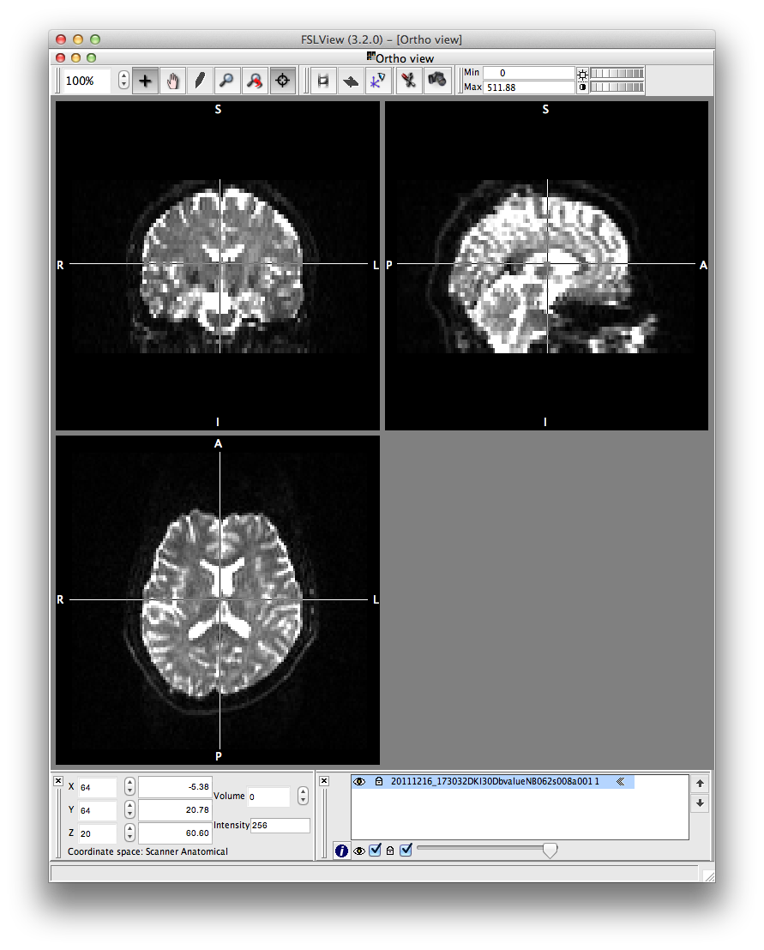
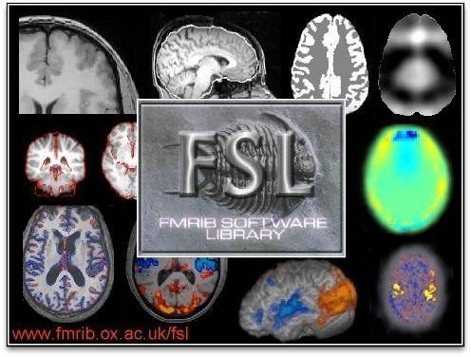
http://fsl.fmrib.ox.ac.uk

Slide 53
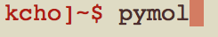

Slide 54
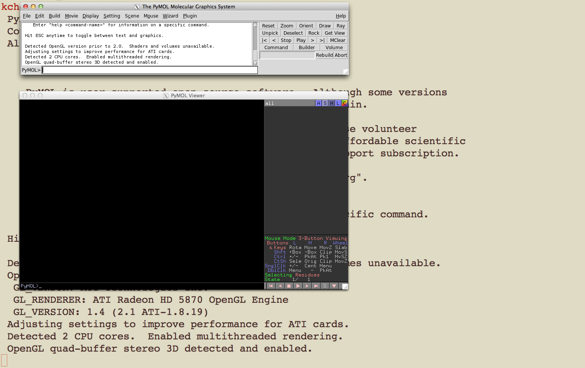

Slide 55
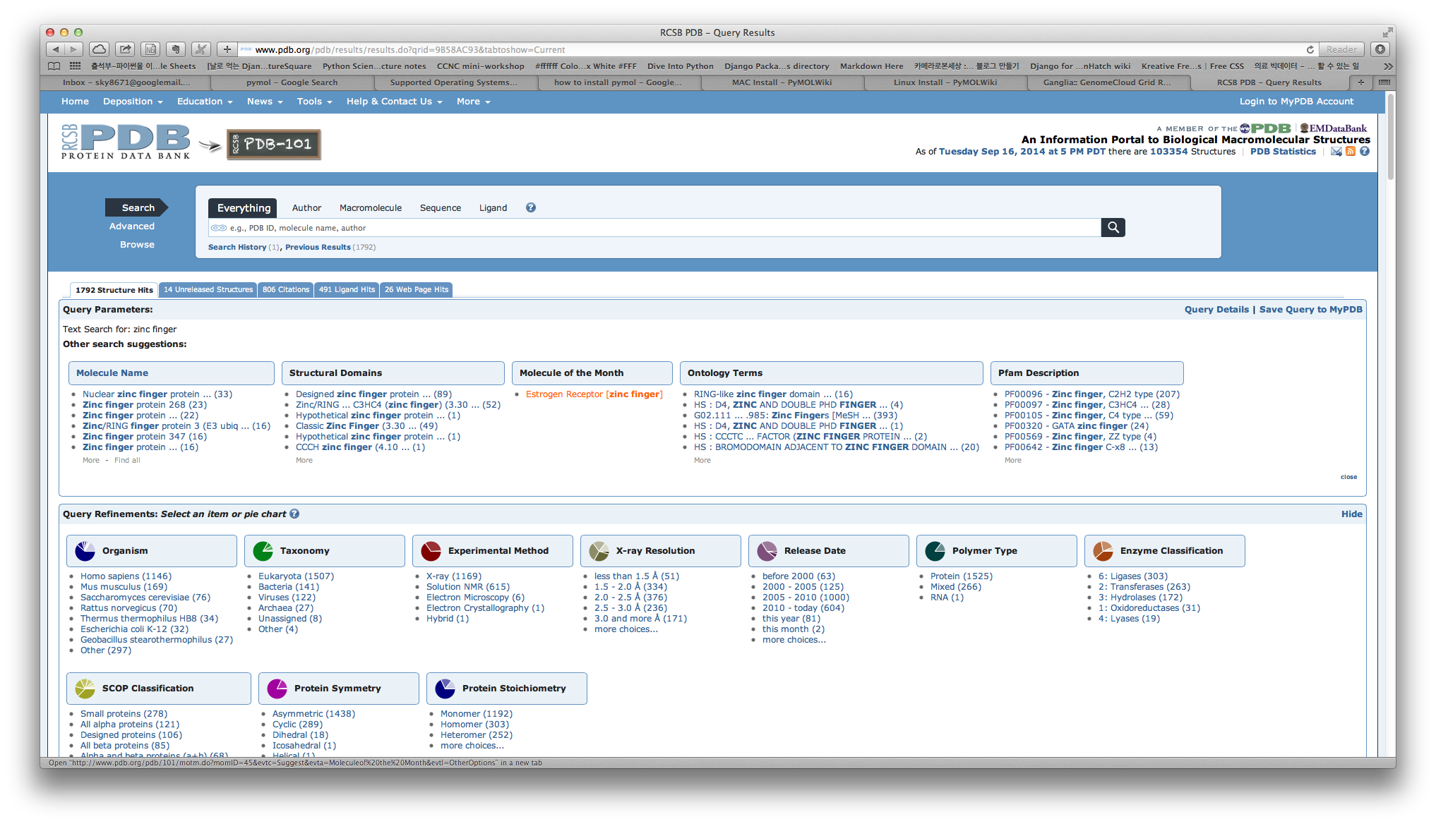

Slide 56
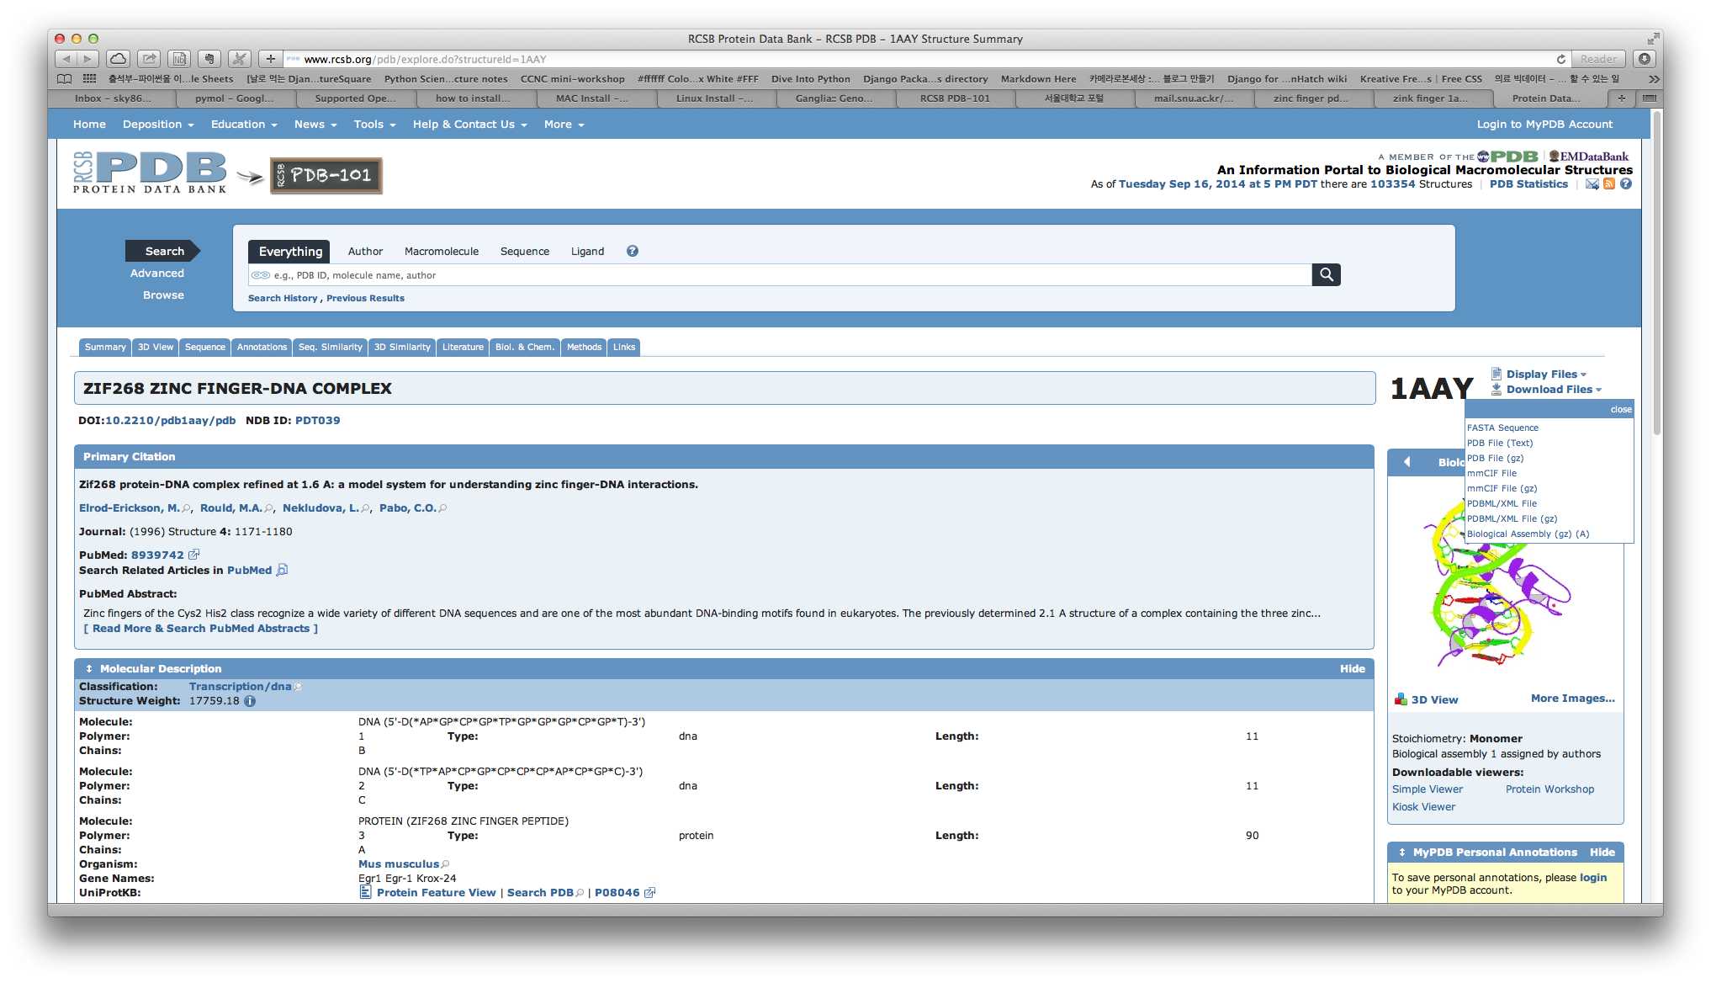

Slide 57
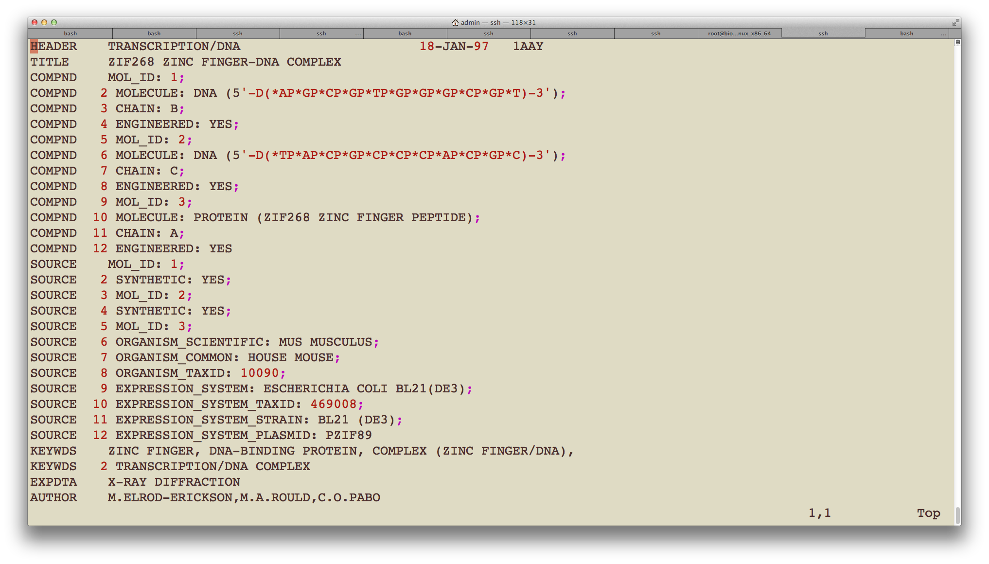

Slide 58
load 1aay.pdb, zinc_finger
hide everything
bg_color white
select zinc_finger, chain a
show cartoon, zinc_finger
color blue, zinc_finger
select dna, chain b or chain c
select dna_backbone, elem p
show cartoon, dna
set cartoon_ring_mode, 3
color green, dna
color forest, dna_backbone
select zinc, resn zn
show spheres, zinc
color gray, zinc
select atoms_pocket, zinc around 5.0 and not zinc
select pocket, byres atoms_pocket
show sticks, pocket
set valence, 1
set_view (\
0.385022461, -0.910319746, -0.151902989,\
-0.748979092, -0.212032005, -0.627752066,\
0.539247334,0.355471820,-0.763447404,\
0.000005471,0.000029832,-134.466125488,\
1.499966264,12.841400146,50.074134827,\
100.975906372,167.958770752,0.000)

Slide 59
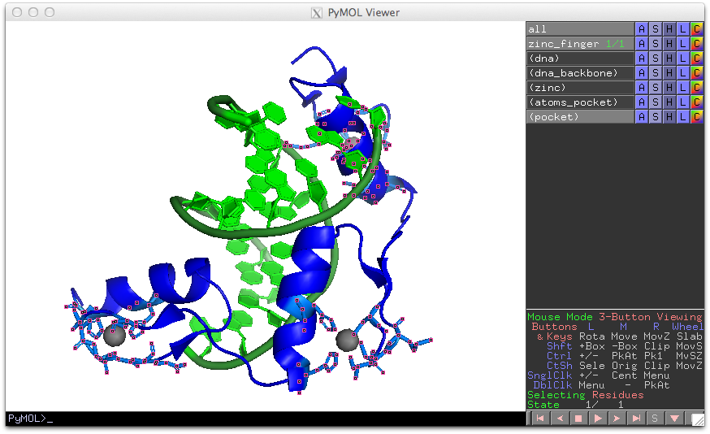

Slide 60
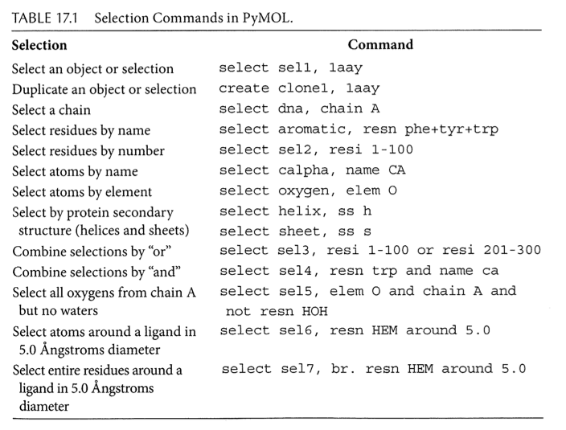

Slide 61
Thanks

Slide 62
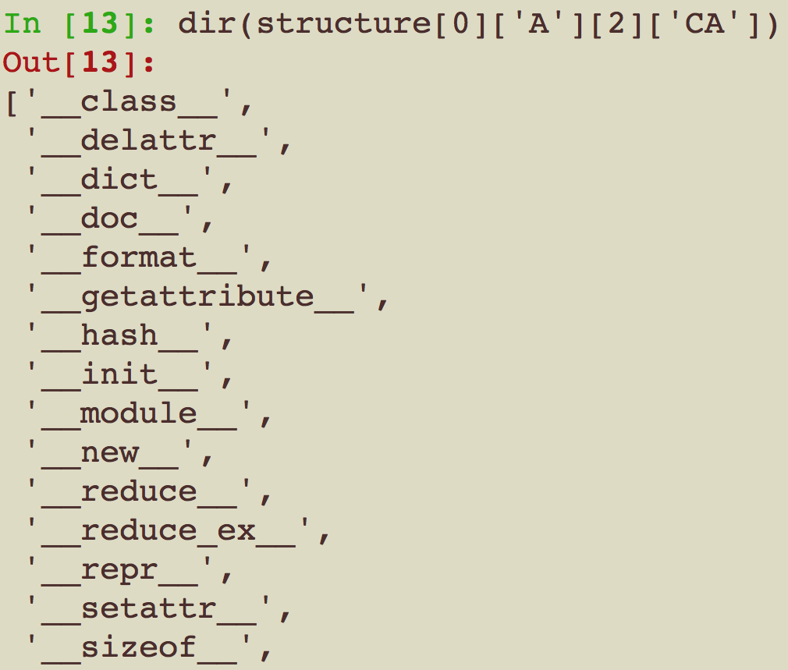

Slide 63
